Slide 1

Mobile Application Development, Fall 2021 Introduction to State Management Part 3

Slide 2
Today’s Agenda
Introduction to Reducers
Creating a Reducer
A Reducer Coding Convention

Slide 3
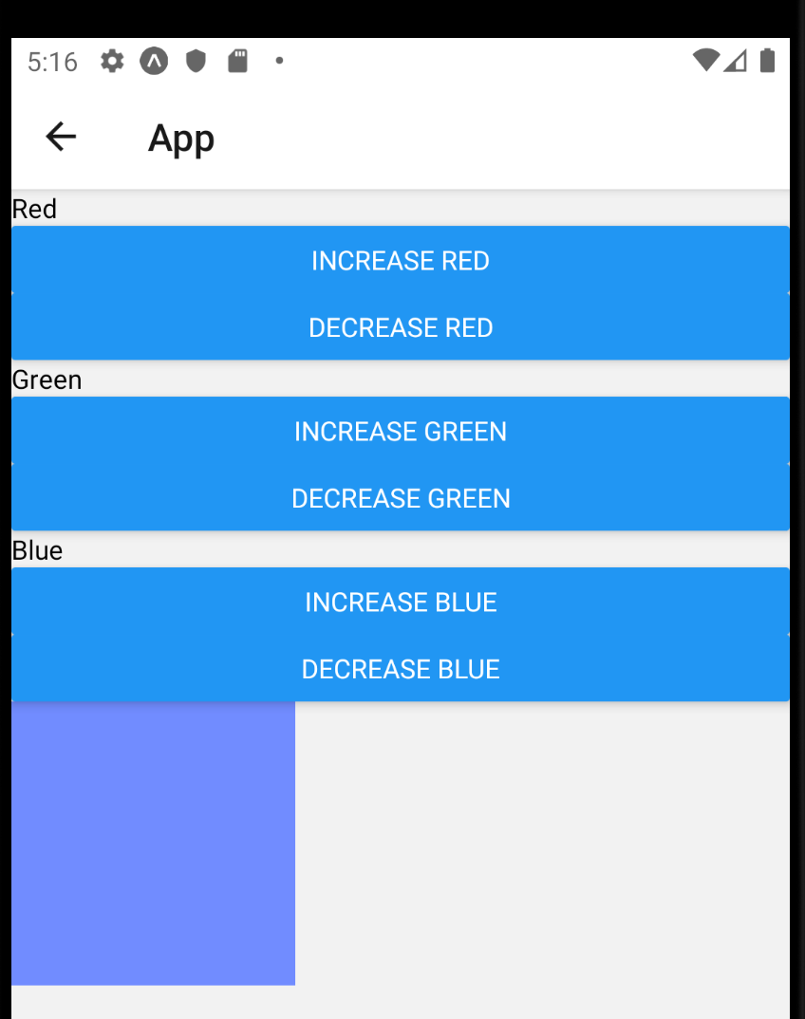
Introduction to Reducers
When last we spoke, we created this lovely work of art!
It declared state in a parent component, and used callback functions to pass functions to alter the state in child components!
It also had some nifty data validation performed in a separate file.

Slide 4
Introduction to Reducers
This app, from a functionality stand point, is done!
BUT!
Ah… what if I told you we could make it even better!
And learn a little more about hooks in the process.

Slide 5
Introduction to Reducers
So, ah, think of this as a stepping stone, that will enable us to reach new exciting things down the line!
Keep that in the back of your mind as we chat about this stuff!

Slide 6
Introduction to Reducers
One thing that I want us to recall about the app:
We have three separate pieces of state that we are working with.
One number for red, one number for green, and one number for blue.
And another thing to keep in mind: these pieces of state are very interrelated.
We need all three pieces of state to achieve our goal of changing the square color.

Slide 7
Introduction to Reducers
And lastly: for now, just note that there are *exactly* six ways that these pieces of data can change.
Two for each color!
Any given color can either go up, or go down, in exactly one way (i.e., the button press).
You could say that the way that our state is changing is precisely known.

Slide 8
Introduction to Reducers
When you have multiple pieces of state that have those two properties:
They are interrelated to each other.
And the ways that they change are precisely known.
That makes our state a great candidate to be managed by a reducer.
What the heck is a reducer?

Slide 9
Introduction to Reducers
Well, first off, they have a very evocative name!
But, er, don’t get too caught up in it.
In a nutshell, reducers are functions that manage changes to objects.
So, great, they’re functions!

Slide 10
Introduction to Reducers
Even more specifically: reducers are functions that always take in two pieces of input.
The first piece of input: an object that stores all of our state data!
So, for the app we just made last time, that object might look like this:
{red: 0, green: 0, blue: 0}

Slide 11
Introduction to Reducers
The second piece of input: is another object.
This object contains properties that describe the change we want to make to our data.
So, for this app, an example of that might look like this:
{colorToChange: ‘red’, amountToChangeBy: 20}

Slide 12
Introduction to Reducers
So if these are our two arguments…
{red: 0, green: 0, blue: 0}
{colorToChange: ‘red’, amountToChangeBy: 20}
Do they remind us of anything?

Slide 13
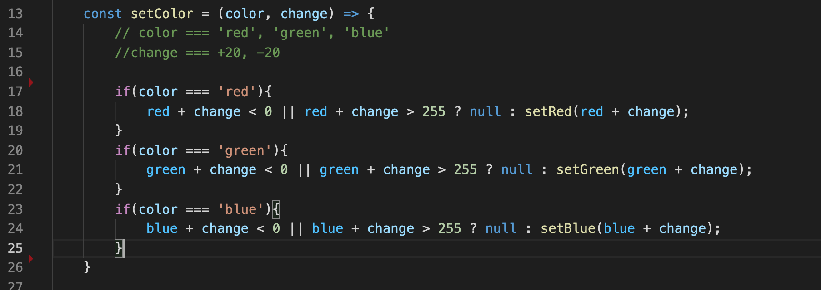
Introduction to Reducers
I mean, they’re not *exactly* the same… but
{colorToChange: ‘red’, amountToChangeBy: 20}
Is basically the same as the input to our setColor function!
It specifies what color we wish to change, and how much we wish to change it by!

Slide 14
Introduction to Reducers
So you can already probably imagine, that these guys:
{red: 0, green: 0, blue: 0}
{colorToChange: ‘red’, amountToChangeBy: 20}
Are going to somehow work with each other, to change the value of the red variable to go from 0 to 20.
We use argument 2 to determine how to change the state variables of argument 1.
But a couple of special caveats to this!

Slide 15
Introduction to Reducers
Caveat 1: You *still* can’t change these state values directly.
So if the object containing the state values was called, maybe, state values:
let stateValues = {red: 0, green: 0, blue: 0}
We couldn’t do something like this:
stateValues.red += 10;

Slide 16
Introduction to Reducers
Caveat 2: Our reducer always returns a value. Namely: An object, which serves as the state!
That’s slightly different from our setColor function we have right now – it doesn’t really return anything.
Don’t worry too much about caveat 2 at this exact moment. The big takeaway for now: our reducer always needs to return something.
OK – we’ve got a good sense as to what Reducers are now. How do we make one?

Slide 17
Today’s Agenda
Introduction to Reducers
Creating a Reducer
A Reducer Coding Convention

Slide 18
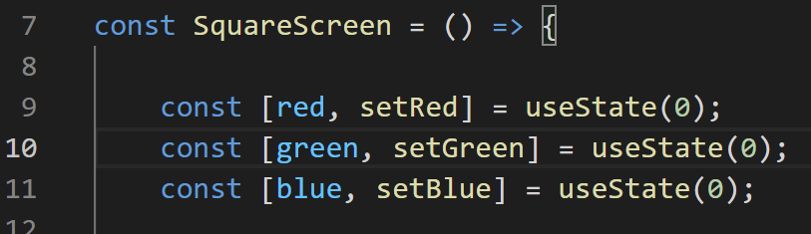
Creating a Reducer
So, now that we know a little bit about what a reducer is and when to use it…
Let’s use one! Let’s refactor our SquareScreen to use a reducer.
We’ll replace all of these calls to useState().
It’s basically an “either or” situation.
You either use useState, or a reducer.
So now we’re converting from one to the other.
SquareScreen.js

Slide 19
Creating a Reducer
So that means that we’re going to basically delete everything we’ve done pertaining to state, because now we’re doing it in a different way!
Feel free to save a different copy of your file for posterity if you are squeamish about deleting code!
SquareScreen.js

Slide 20
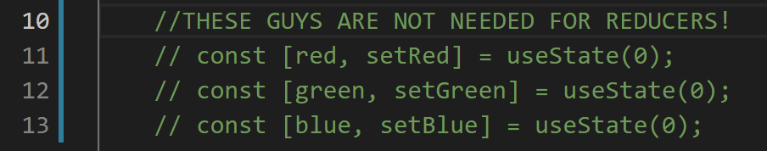
Creating a Reducer
So we’re not going to use the useState hook!
SquareScreen.js

Slide 21
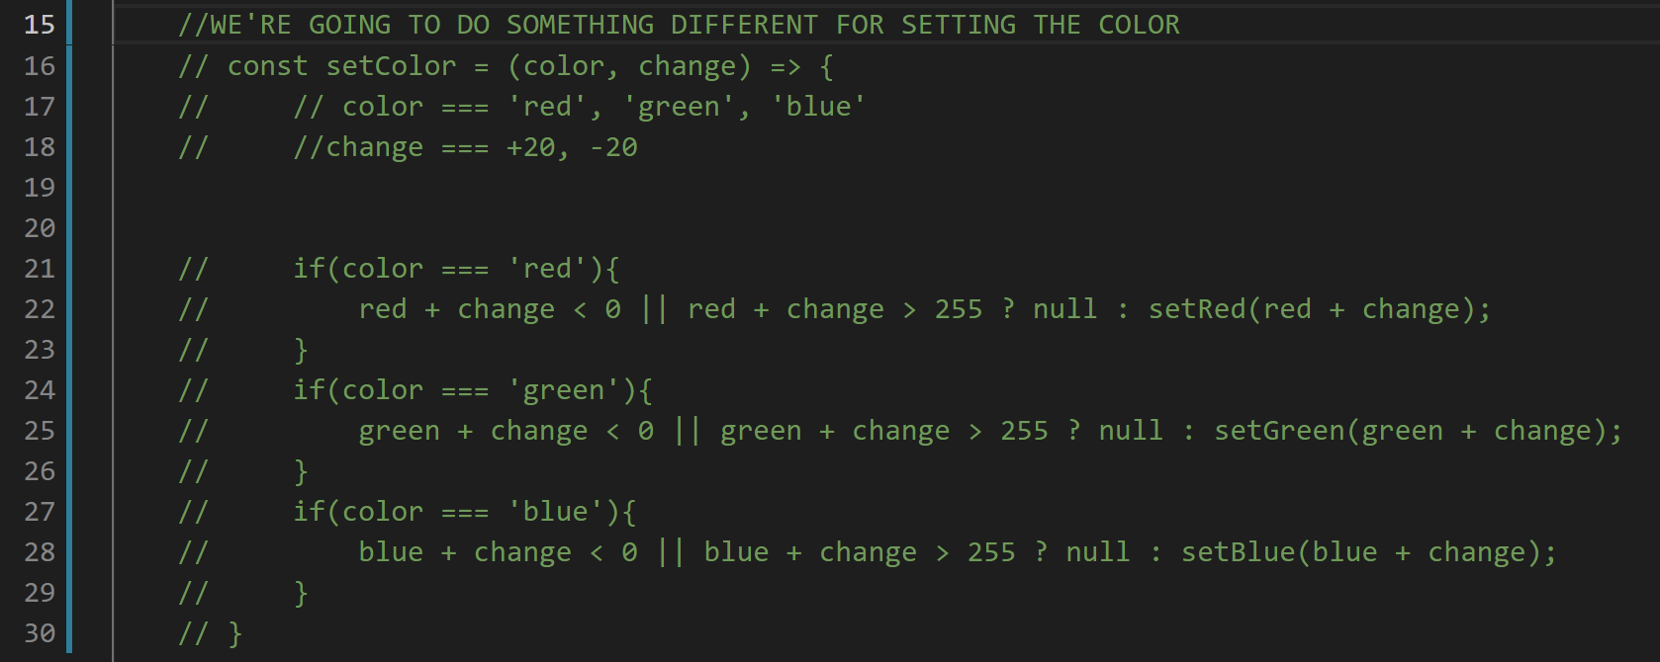
Creating a Reducer
SquareScreen.js
The setColor function as we know and love it is no longer needed either!

Slide 22
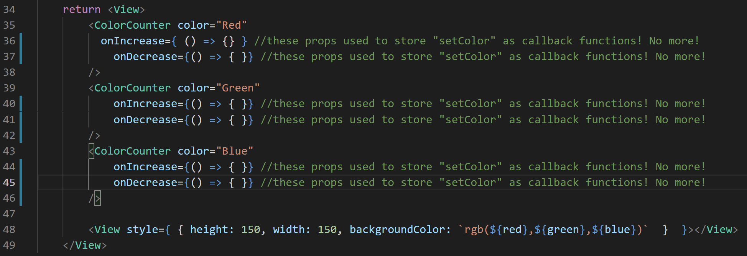
Creating a Reducer
SquareScreen.js
And if we aren’t using setColor any more, it makes sense to not be passing setColor down as a prop either!

Slide 23
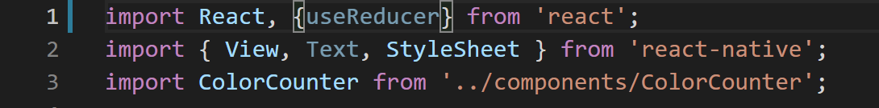

Creating a Reducer
SquareScreen.js
OK, great! a blank slate!
Now, instead of using useState, we are going to use that alternative hook, useReducer.
So we better import it!
This is a function that we can call inside of our functional component!

Slide 24
Creating a Reducer
SquareScreen.js
And then we can start using our reducer with a line like the above!
There’s a lot there, and we’re break it all down eventually, but for now… some things to note…
useReducer is the name of the hook – that’s us invoking the thing we just imported.
It takes in two arguments.
reducer here is our reducer function – this is something we need to write but we haven’t yet.
And this object is that “default state data” object, like we were talking about before!
Here, we initialize all three colors to 0.

Slide 25
Creating a Reducer
SquareScreen.js
And we can see that we’re using array dereferencing again, but with different variable names.
Here, the variable names are state and dispatch.
state is an object, and it is going to be how we access our state values.
It is *very* similar to the ‘red’, ‘green’, and ‘blue’ variables that were being returned by useState.
Except now it is an object, that will have all of our values! A red, green, and blue property all rolled into one object.
We’ll come back to dispatch in just a second!

Slide 26
Creating a Reducer
SquareScreen.js
First, let’s chat a bit about this reducer function I mentioned.
This is a function that we need to define.
Namely, it’s the thing that we were talking about before! The thing that takes in two arguments!
The first argument is “an object that holds the current state”
The second argument is “an object that describes how to update the state”

Slide 27
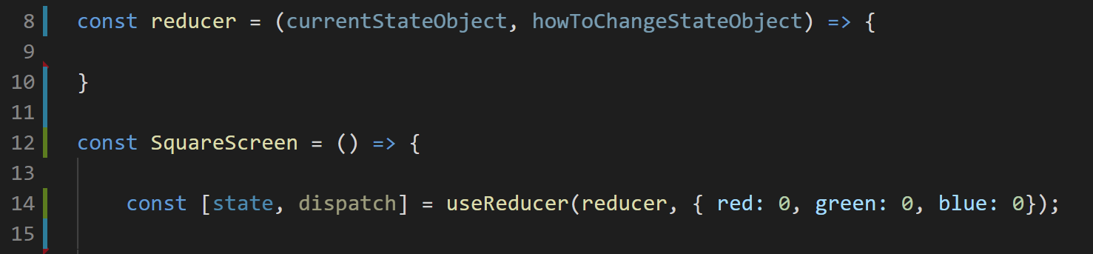
Creating a Reducer
SquareScreen.js
So to get thing started, it might be something like this, right?
We are defining our reducer function to be stored in a variable called “reducer”
That function currently has an empty body
And has those two parameters we just talked about!
But those parameters are a little wordy right now…

Slide 28
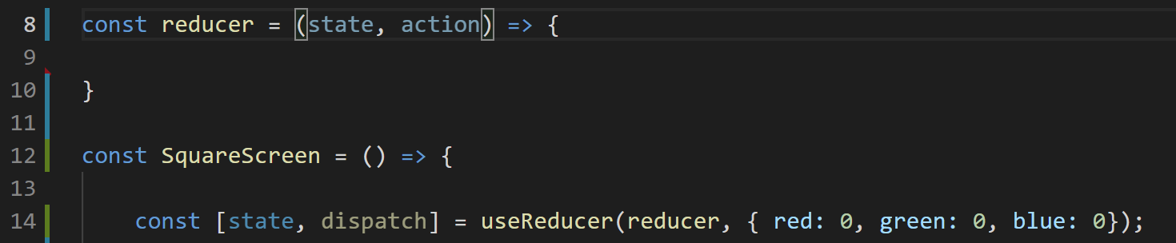
Creating a Reducer
SquareScreen.js
These are the convention names for those parameters
state
action
Action basically means “what change do we want to make”?
Are we increasing red?
Decreasing green?
What color are we changing, and by how much?
It is an object that teaches you how to change your state object.

Slide 29
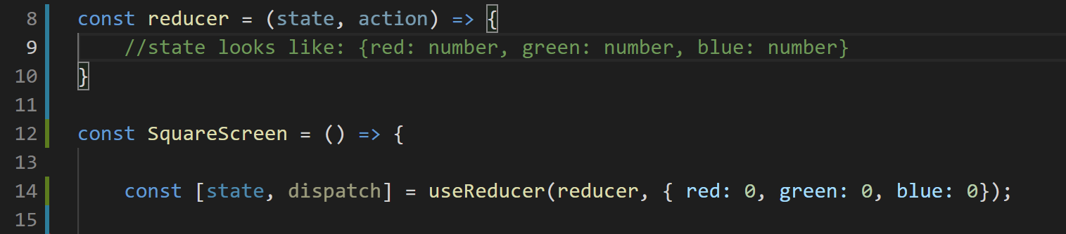
Creating a Reducer
SquareScreen.js
When first getting started, its not a bad idea to write little comments to yourself about what you would expect the form of these variables should be.
In this situation for this app, state probably looks like how we’ve already discussed it / defined it in our useReducer line.
i.e., it is an object with three properties, one for each color.
And each of those properties stores a number, i.e., the amount of that color.

Slide 30
Creating a Reducer
SquareScreen.js
And as we discussed, this app is a good candidate for a reducer because we know all of the possible ways that the state values might change.
There’s 6 total ways they can change:
red goes up by 20
red goes down by 20
green goes up by 20
green goes down by 20
blue goes up by 20
blue goes down by 20.

Slide 31
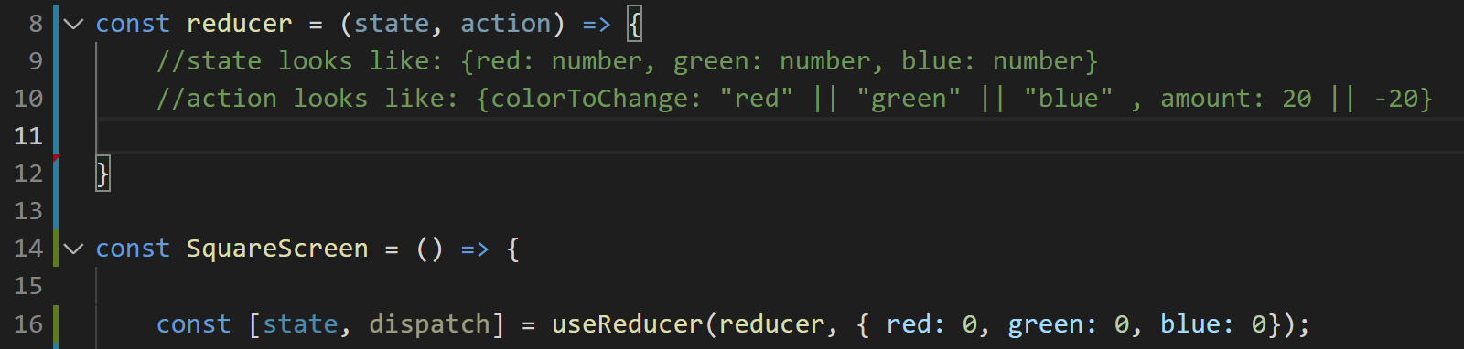
Creating a Reducer
SquareScreen.js
We can capture all six of those changes by capturing two variables:
Which is the color that is changing
How much is it changing by.
So with that insight, we can make those the variables of that action parameter.
Again, here we have three possibilities for the first variable, and two possibilities for the 2nd.
3 * 2 is 6. Lovely!

Slide 32
Creating a Reducer
SquareScreen.js
So now, in the body of the function itself, we want to specify what we want to do for each different color.
We could do this using if statements, like before, or we could use a switch statement.
Just for the sake of variety, let’s use a switch statement this time.
The syntax is essentially the same here as it is in Java.

Slide 33
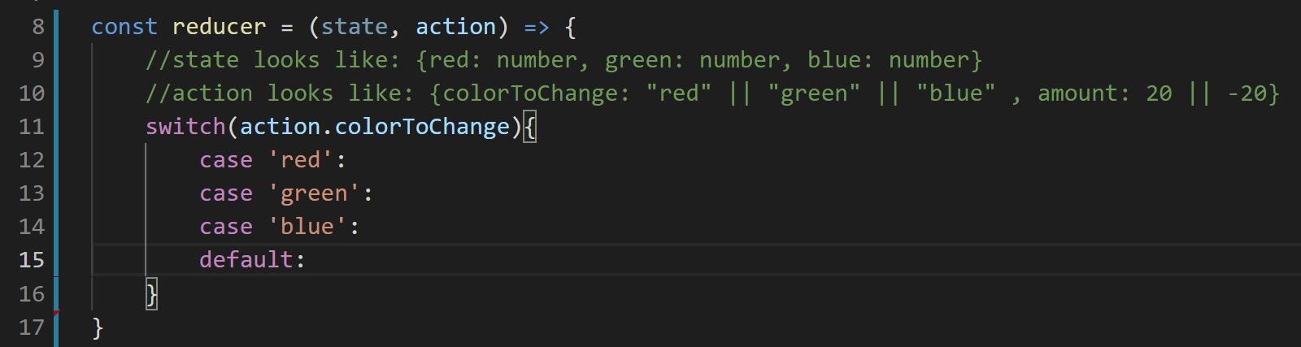
Creating a Reducer
SquareScreen.js
So, something like this to start, yeah?
We switch over what color we want to change as specified in the action variable.
And we’ll do different things based on that color!
The default case will execute if somehow “colorToChange” ever gets set to something other than ‘red’, ‘green’, or ‘blue’

Slide 34
Creating a Reducer
SquareScreen.js
So, let’s handle the cases for each color!
And for now: let’s not worry about the validation we worked so hard on before.
i.e., it’s Ok if the number goes above 255 or below 0.
We’ll bring validation back later!
So, for red, let’s think for a second… what are ways that, based on what we have so far, we might intuitively want to implement this?

Slide 35
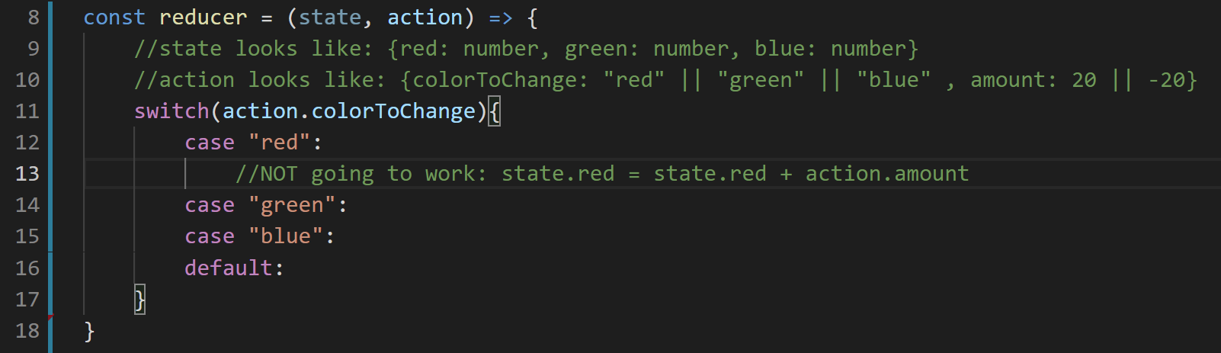

Creating a Reducer
SquareScreen.js
I don’t know about you, but this is what my brain kinda defaults to.
But as we can see with that angry note before hand: this isn’t going to work.
Because just as like our experiences with useState, we can’t modify these variables directly with reducers, either!

Slide 36
Creating a Reducer
SquareScreen.js
Now, before, in useState land, we had that nice setter function that the hook returned for us, and *that’s* how we altered the state.
How do we do the moral equivalent of that here?
The upshot: we are going to COMPLETELY REBUILD our state object.
But this newly constructed object will have our revised values!
It’s syntactically similar to something we’ve seen before!

Slide 37
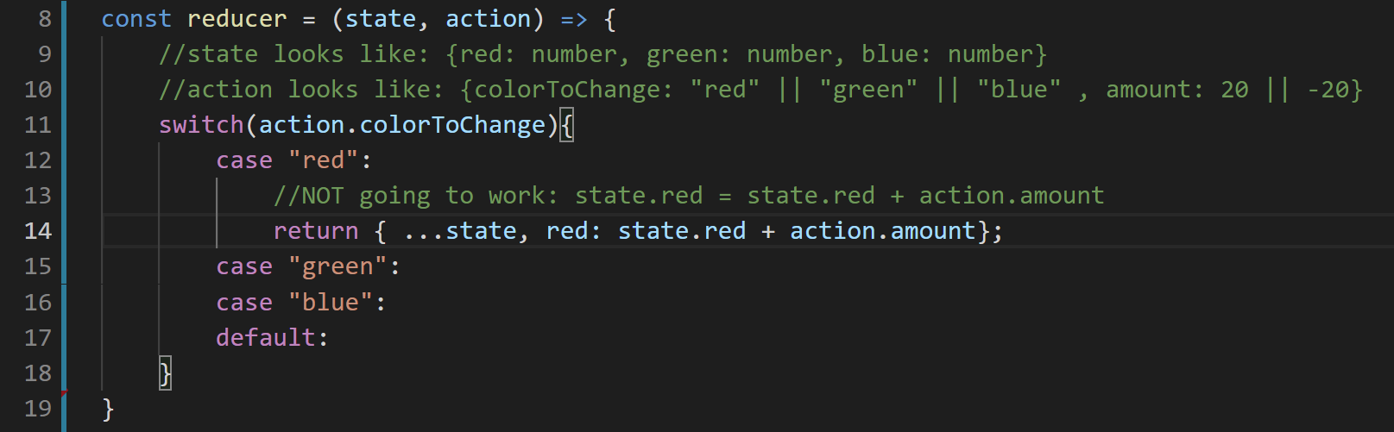

Creating a Reducer
SquareScreen.js
Something a little bit like this line!

Slide 38
Creating a Reducer
SquareScreen.js
The return keyword means what it always does: we are returning a value.
The { and } braces here mean that we are constructing a new JavaScript object.
i.e., we are specifying the object that we are going to return.

Slide 39
Creating a Reducer
SquareScreen.js
The …state basically means “hey, this new object I’m making should basically just copy and paste all of the values of the state object!”
And then this final bit, after the comma, is specifying “please overwrite the value of red in the object to be the following:
Whatever the value of red currently is (as stored in the state variable).
Plus however much it should change by (as stored in the action variable).

Slide 40
Creating a Reducer
SquareScreen.js
And again: note that *none* of this is changing our state object directly.
We are copying and pasting the contents of that object into a *different* object, a new one that we are making.
And then changing the value of that new object.

Slide 41
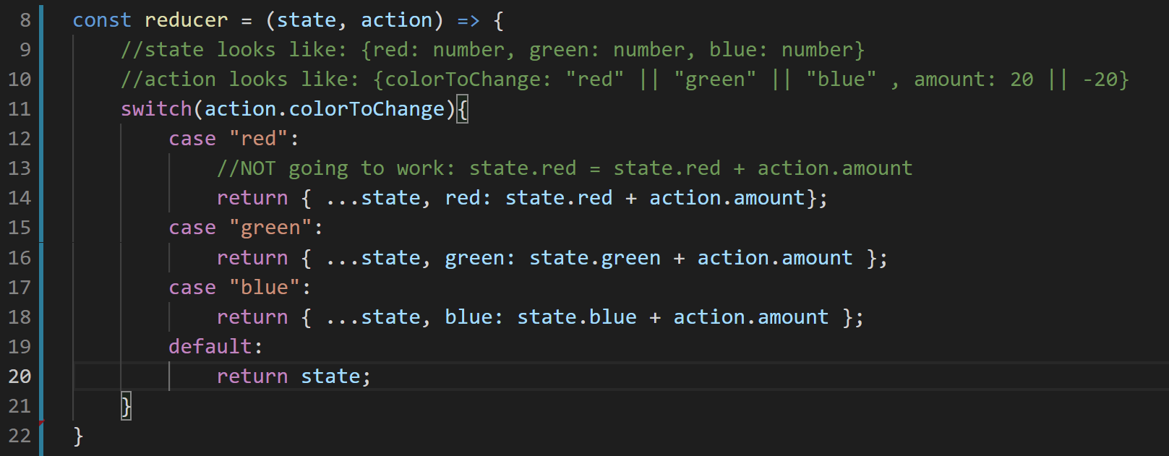
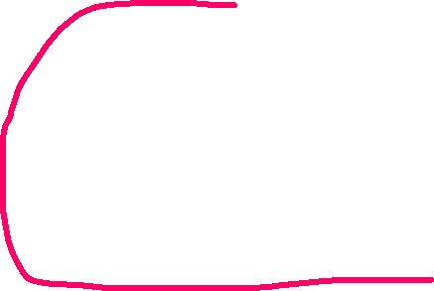
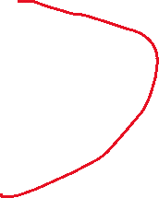
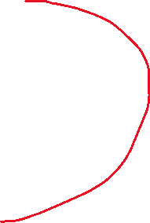
Creating a Reducer
SquareScreen.js
So, great, that’s red done! Let’s do the same for green and blue!
Be very careful to change all the names you need to!
We can also handle the default case!
If the action specifies a “bad” name for the color, let’s just return the current state, i.e., don’t make any changes to the state.

Slide 42
Creating a Reducer
SquareScreen.js
And recall how we said that our reducer function needed to *always* return a value that was an object that represents what the state should be?
Well, look at that, we did it!
No matter what happens here, we return an object that specifies all three colors.

Slide 43
Creating a Reducer
So, fantastic! We’ve defined our reducer function!
But we still aren’t actually *using* it yet.
Odds are high that if you’ve been following along at home, you’d still have lots of error messages at this point.
Let’s deal with this!
Let’s use our cool new reducer function inside of our SquareScreen function!

Slide 44
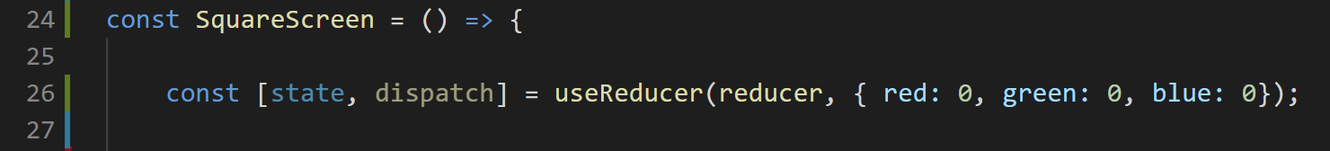


Creating a Reducer
SquareScreen.js
This is basically what we had before!
We used the useReducer hook, giving it two things…
The first thing was this reducer function…
Which we *just* made! This is the function that that switch statement inside of it!
And the second argument was what the “default” starting state should be.

Slide 45
Creating a Reducer
SquareScreen.js
And when we call use reducer, it gives us back two things.
state is whatever the current state is.
Just like how “useState” returned a variable that represented the current value of a bit of state.
And dispatch remains a mystery to us!
But here’s the big clue: it’s how we’re actually going to *use* the reducer and make our screen re-render with our new state.

Slide 46
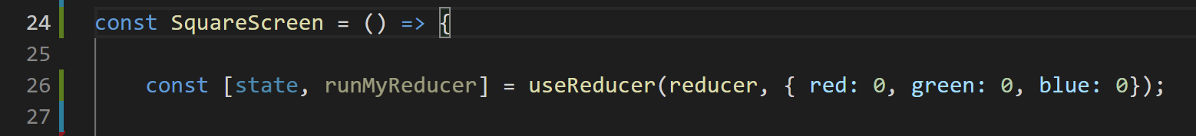
Creating a Reducer
SquareScreen.js
So, “dispatch” is the conventional name for this thing, but like, we can name is anything we want, right? It’s just a variable.
And really, what it’s doing is running that reducer we just made!
So if you wanted, you could call this variable runMyReducer if that helps you know what it is and what it does!

Slide 47
Creating a Reducer
SquareScreen.js
But let’s stick to convention for now, and change the name back to dispatch.
dispatch is a function, that will ultimately invoke our reducer function.
And dispatch takes in one argument: the object that will ultimately be our ‘action’ object as it is passed down to our reducer function.

Slide 48
Creating a Reducer
SquareScreen.js
But let’s stick to convention for now, and change the name back to dispatch.
dispatch is a function, that will ultimately invoke our reducer function.
And dispatch takes in one argument: the object that will ultimately be our ‘action’ object as it is passed down to our reducer function.
And with this: we perhaps have everything that we need to actually use our reducer to change the state!

Slide 49
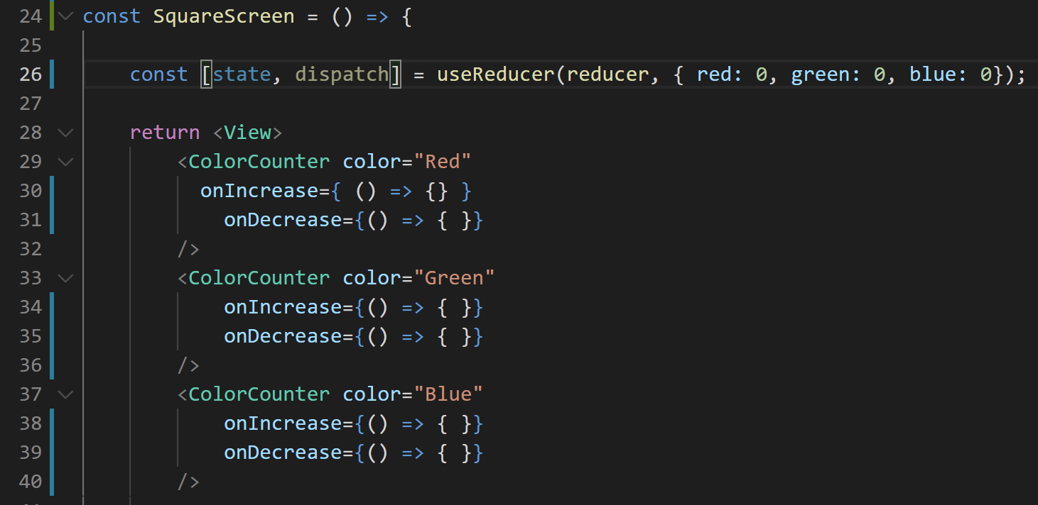
Creating a Reducer
SquareScreen.js
So with all of this in mind…
How might we update our functional component here, to make use of dispatch
And in so doing, our reducer?

Slide 50



Creating a Reducer
SquareScreen.js
Well, we’re going to be specifying these callback methods again!
It’s just this time, instead of the callback method being setColor as before, now it will be a call to dispatch!

Slide 51
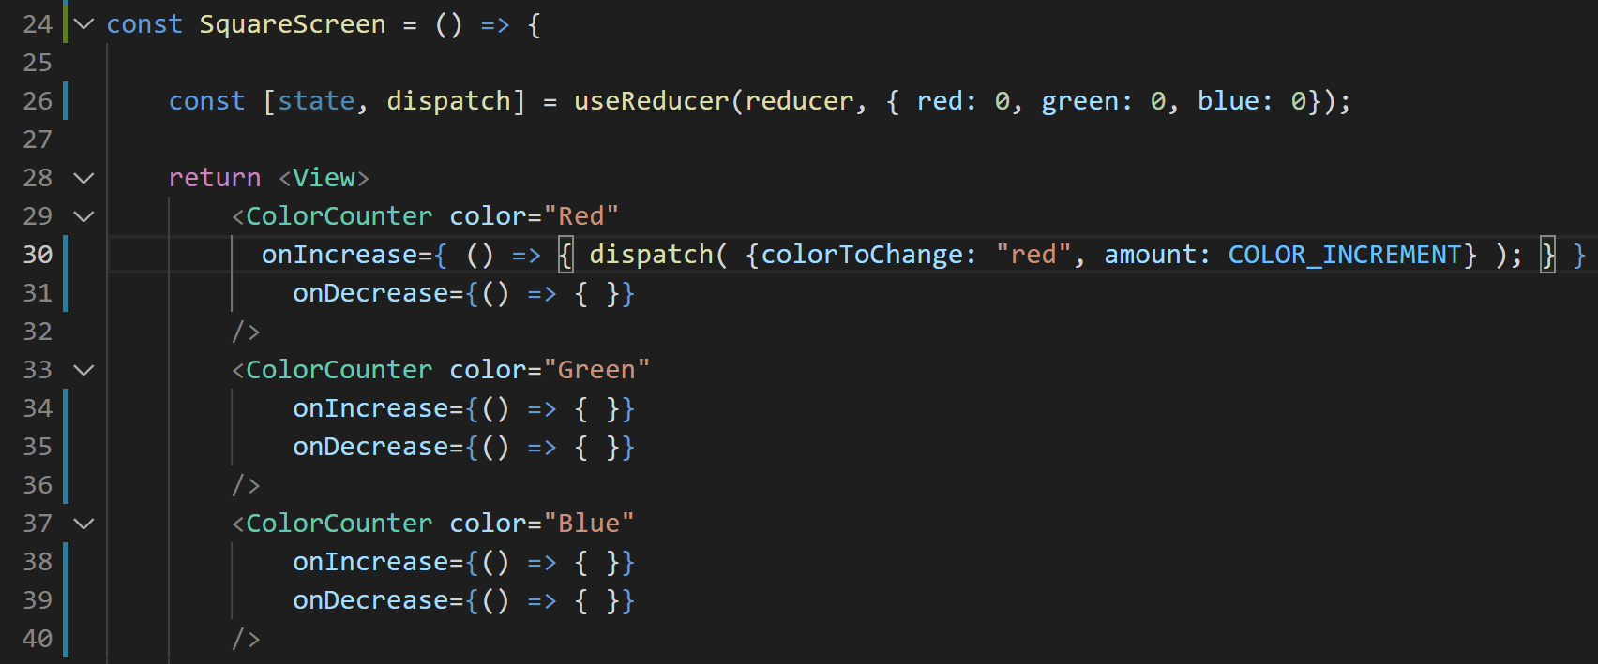
Creating a Reducer
SquareScreen.js
So, maybe a little something like this, yeah?
This is saying, “hey, the ColorCounter component has a prop called onIncrease.
onIncrease is a function that has no parameters, and whose body is a call to the dispatch function.
The dispatch function takes one argument: an object with two properties (colorToChange and amount)

Slide 52
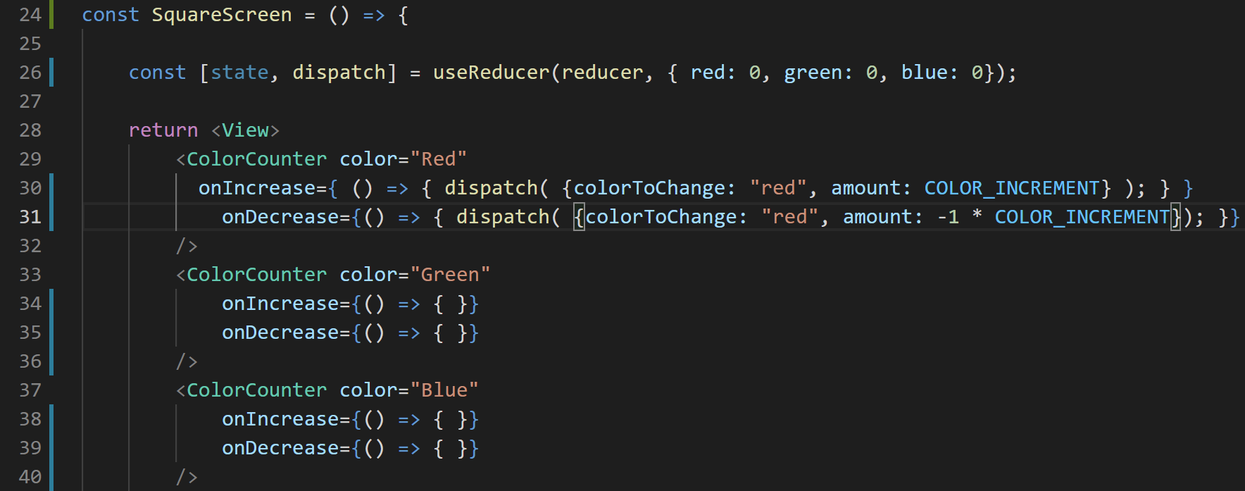
Creating a Reducer
SquareScreen.js
And we can give onDecrease a very similar treatment!
The big difference that the amount to change by is now the negation of COLOR_INCREMENT.

Slide 53
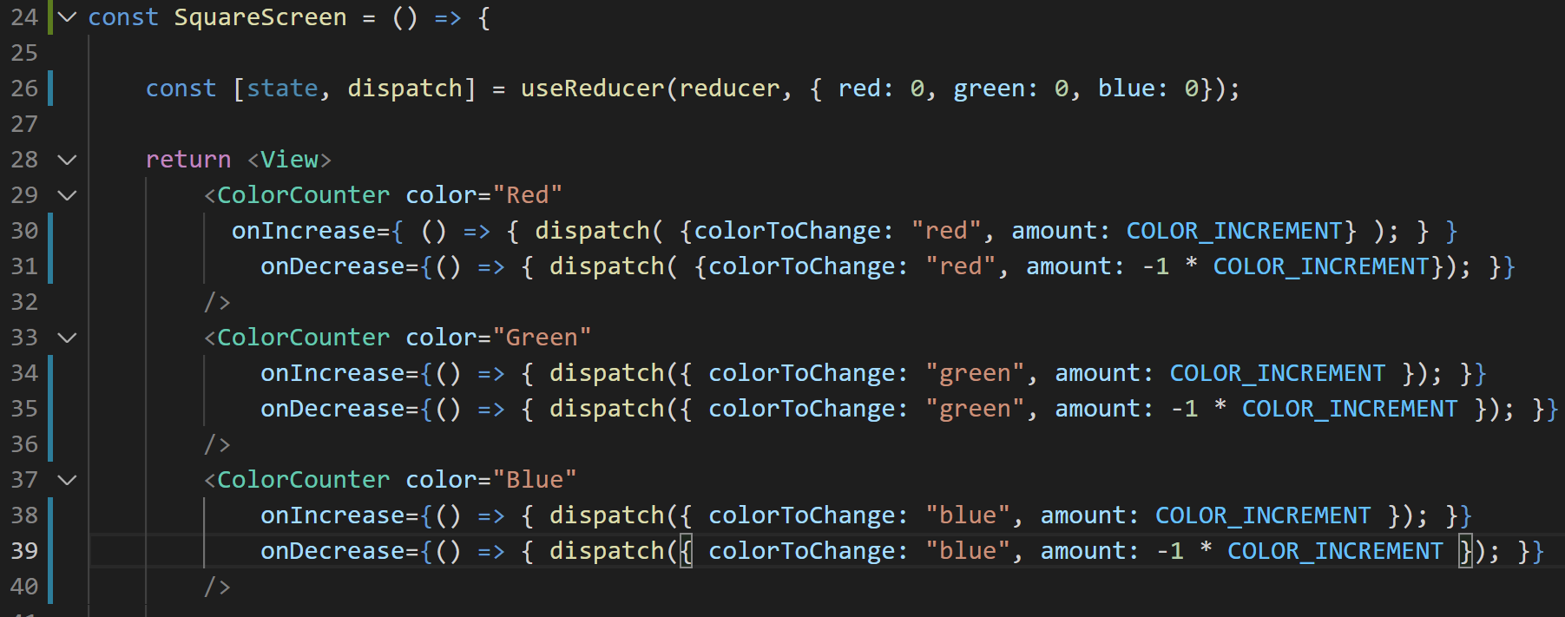
Creating a Reducer
SquareScreen.js
And with that in place, we can now do the same for all of these colors!
Very nice!

Slide 54
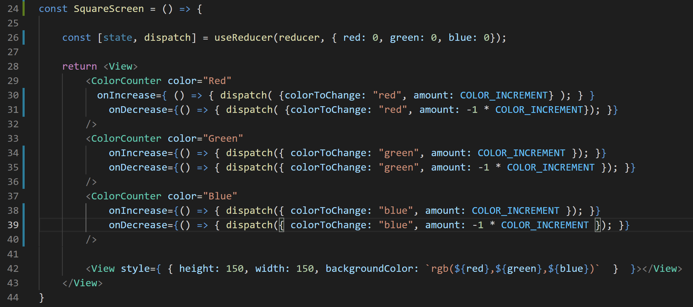
Creating a Reducer
SquareScreen.js
Before we can call it a day, we need to change one more thing!
Before, our View component that represented the color reference red, green, and blue
i.e, the variables we got from the useState hook. We don’t have those any more with this new imagining!

Slide 55
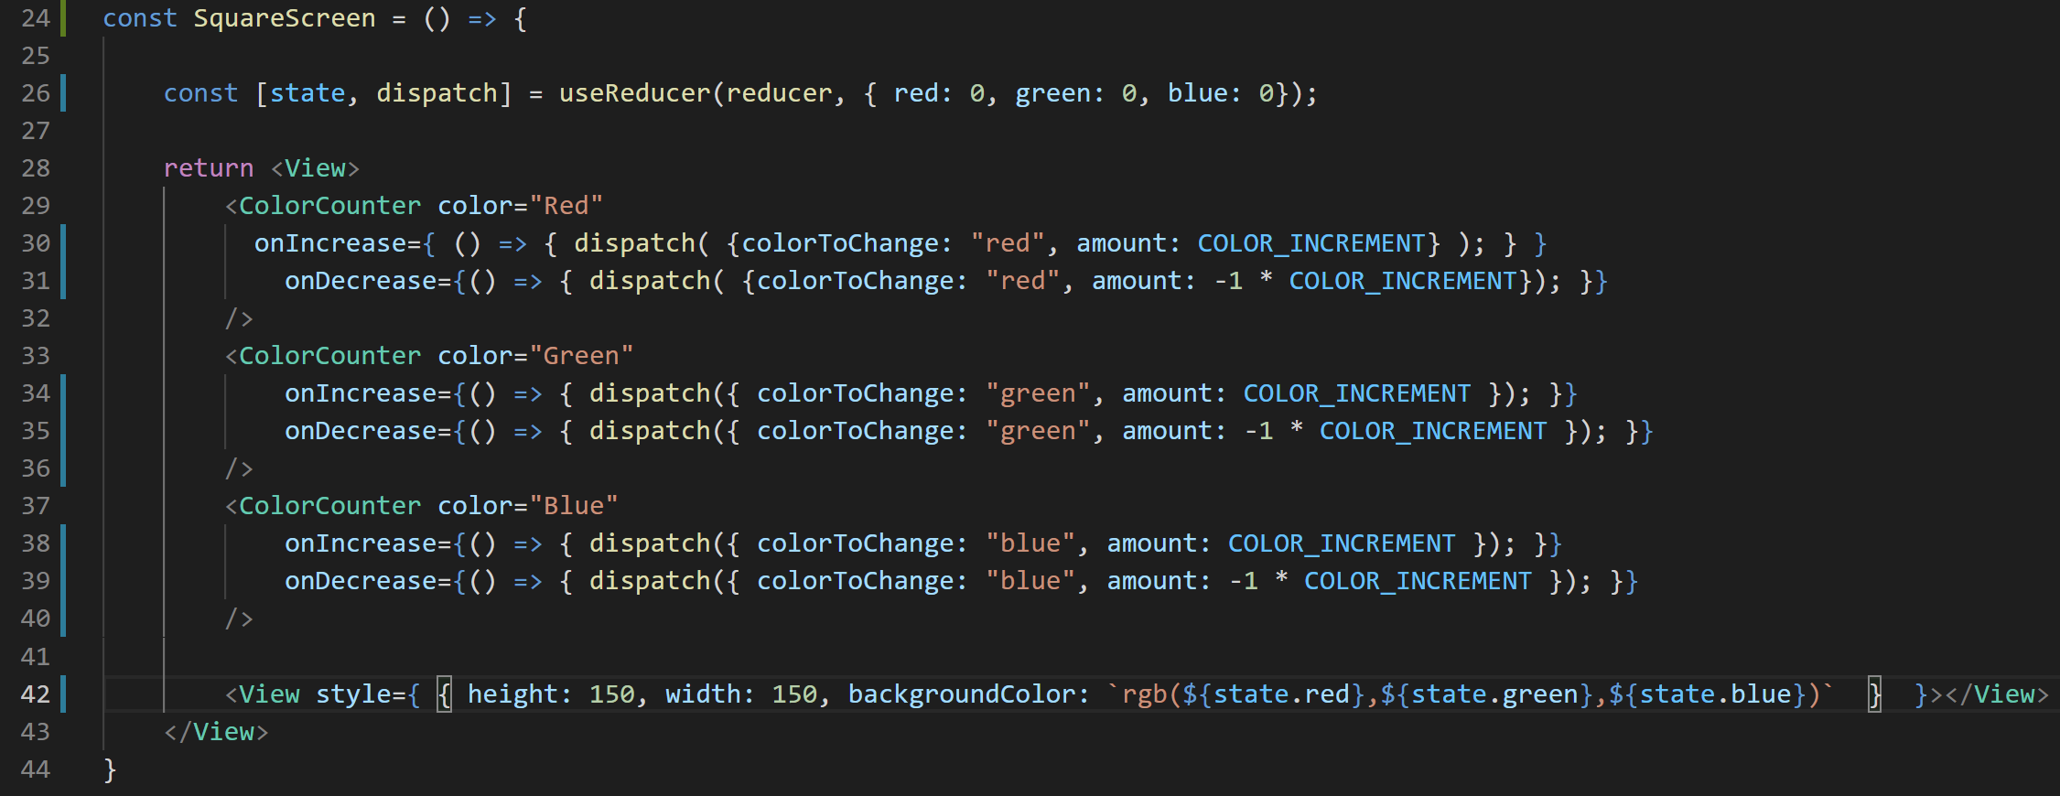
Creating a Reducer
SquareScreen.js
The “normal” way to fix that is simply to reference the appropriate properties within our state object.

Slide 56
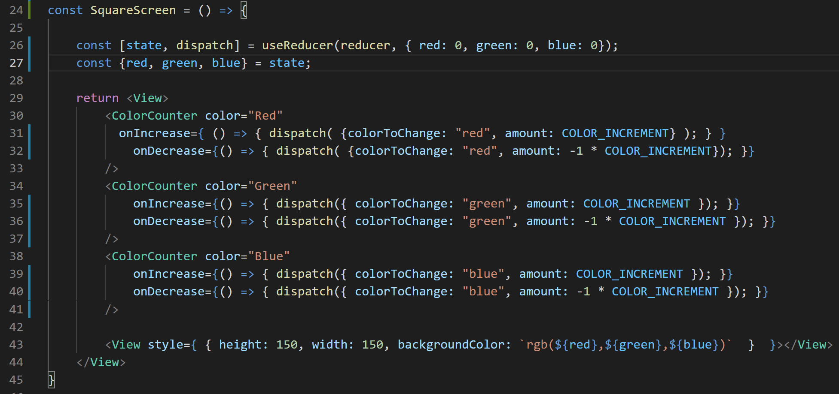
Creating a Reducer
SquareScreen.js
But if you wanted, you could also make use of destructuring of the state object, to “regain access” to variables named red, green, and blue if you so desired.
Here, we destructure using the { } symbols, because we are destructuring an object, instead of an array.

Slide 57
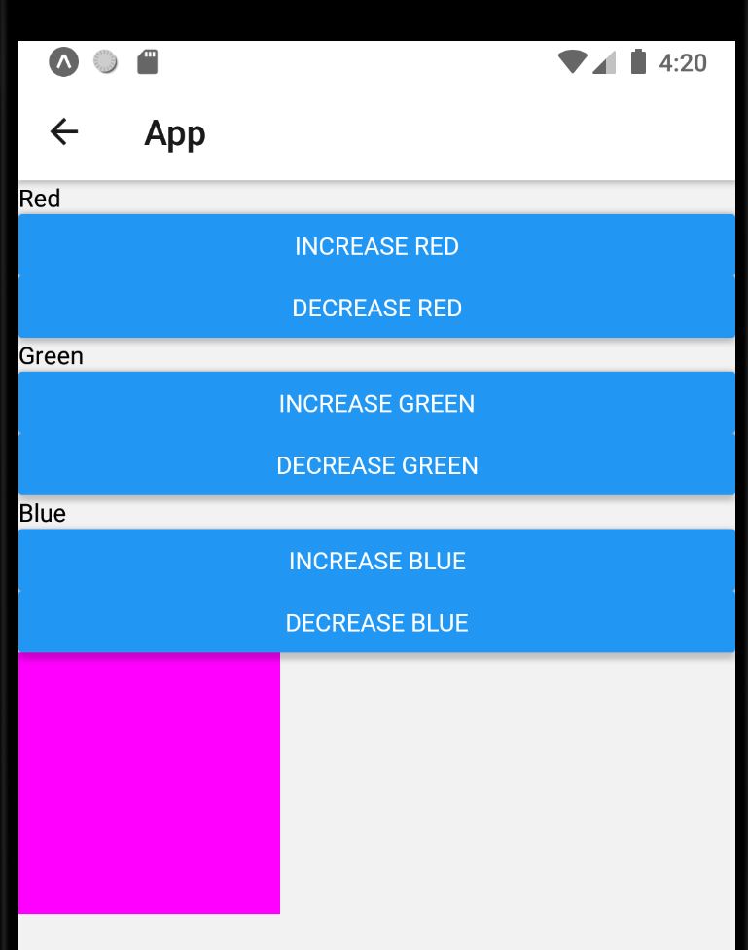
Creating a Reducer
Regardless, however you did it, it should work now!
Just as before!

Slide 58
Creating a Reducer
To be clear: what we did didn’t buy us any additional new functionality!
Nor did it particularly improve performance!
What it *did* do though is introduce us to Reducers.
And there’s going to be stuff later on down the line that will be much easier to appreciate with having a tiny bit of reducer knowledge under our belts!

Slide 59
Creating a Reducer
Let’s re-add validation back in.
Any bets on to how we’re gonna do it?
Maybe as a first “mind’s eye” programming question – where-ish do you think the validation should happen?

Slide 60
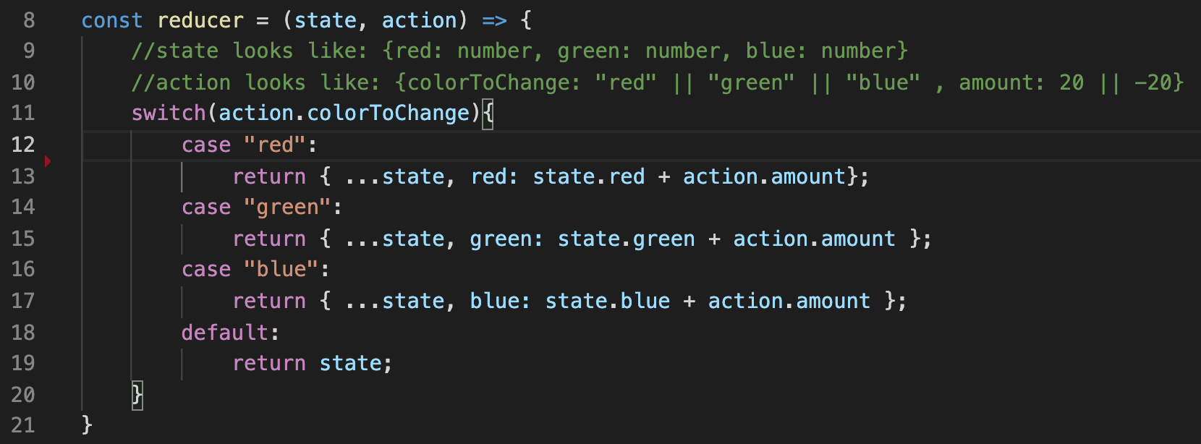
Creating a Reducer
SquareScreen.js
Our reducer function seems like a reasonable place!
This is where we change the state, so it seems like a good place to check that what we’re changing the state to is something that we actually like!

Slide 61
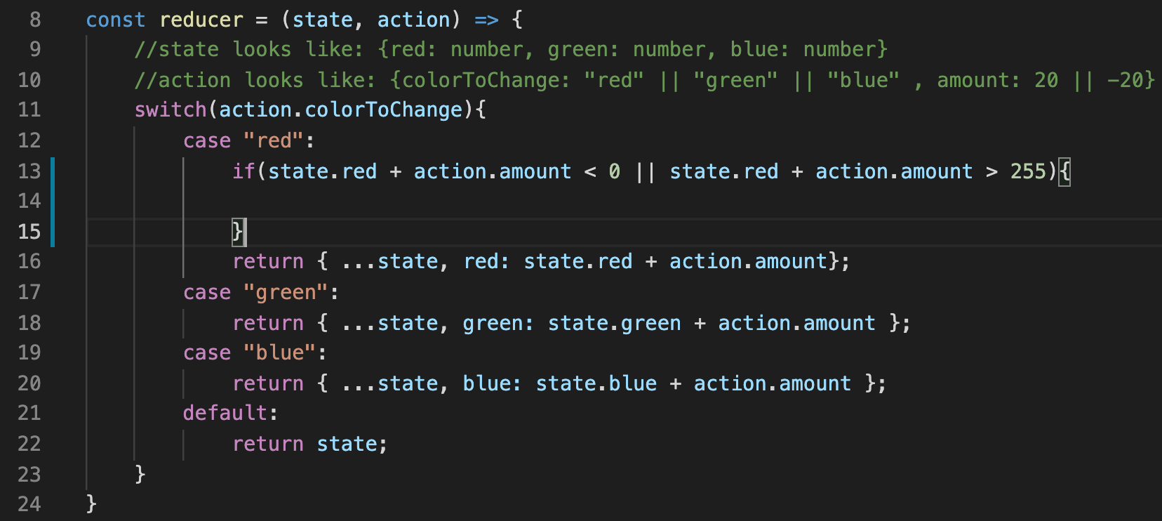
Creating a Reducer
SquareScreen.js
So, you know, basically what we had before seems good, yeah?
An if statement, checking to see if the current amount plus the amount to change by puts us either too low or too high.
But what do we do in the body of the if?

Slide 62
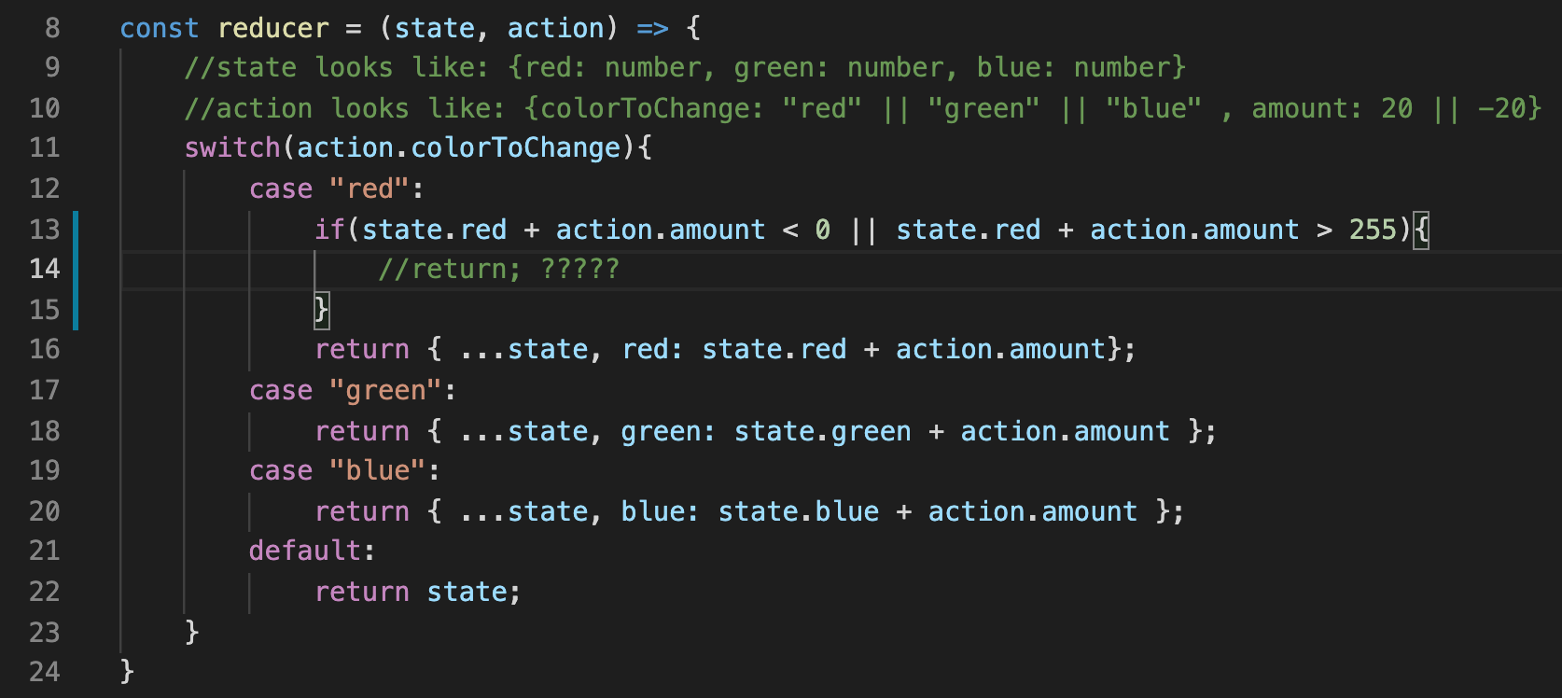
Creating a Reducer
SquareScreen.js
You might be tempted to just put a return statement here, but what’s the gotcha?
A reducer *always* needs to return an object that represents the state!

Slide 63
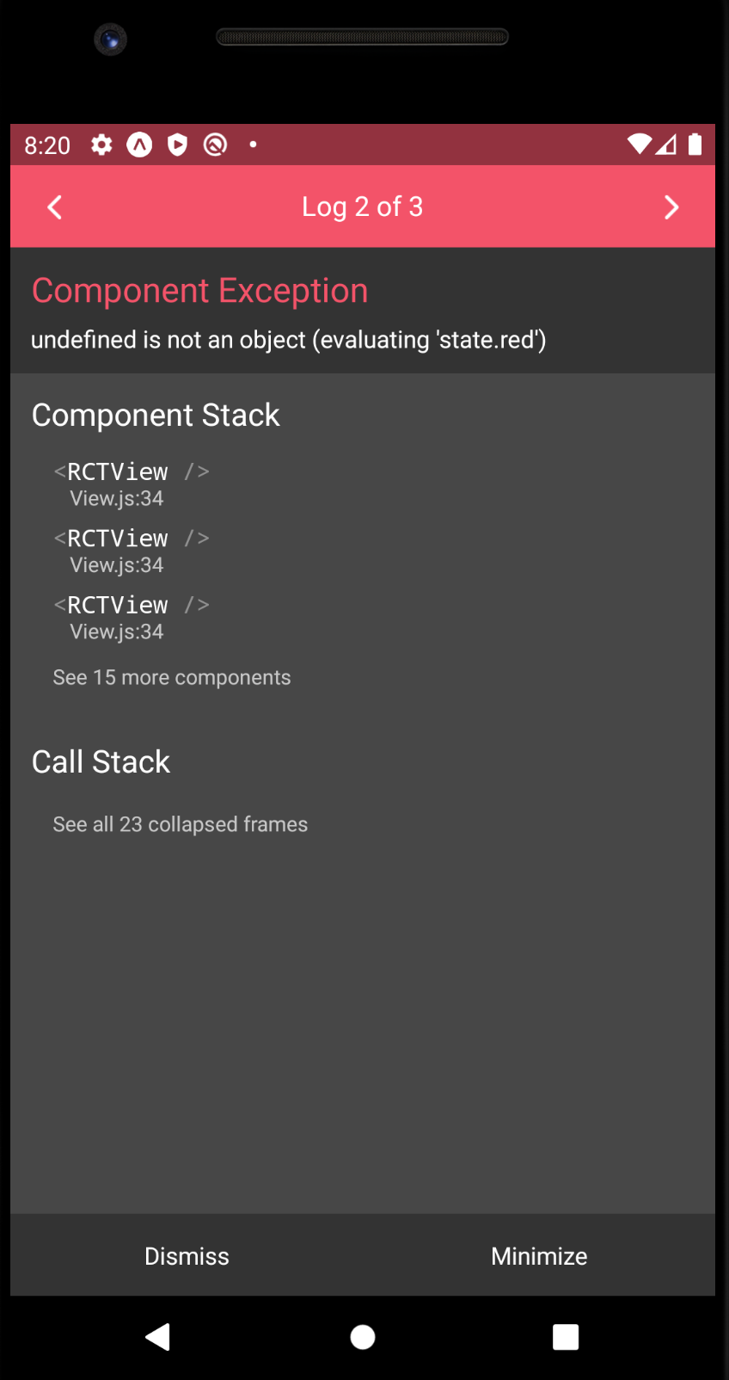
Creating a Reducer
Otherwise, you’ll end up with an error message that looks like this!
Here, we returned “nothing” (i.e., undefined), and it is sad because it wanted an object that contained a property for ’red’
And so it freaked out and produced an error when it tried looking for the ‘red’ property on an undefined object.
And hopefully that makes sense, right?

Slide 64
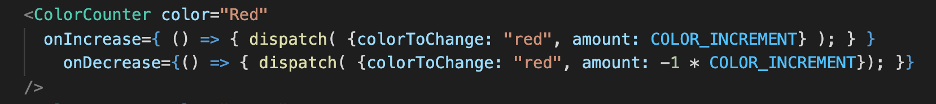
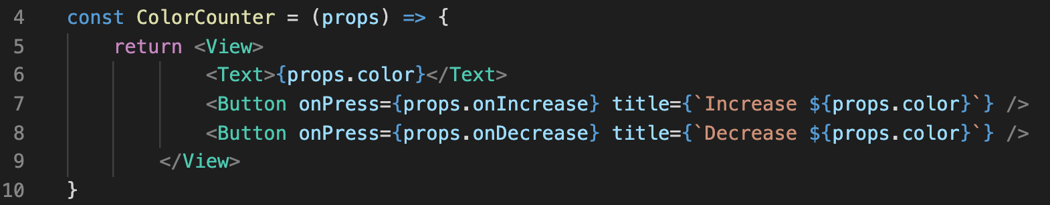
Creating a Reducer
SquareScreen.js
We pass the “dispatch” function to our ColorCounter components via the onIncrease and onDecrease props.
ColorCounter.js
Those get attached to ColorCounter’s Button components as their onPress handlers.
i.e., every time a button is pushed, dispatch is called.

Slide 65
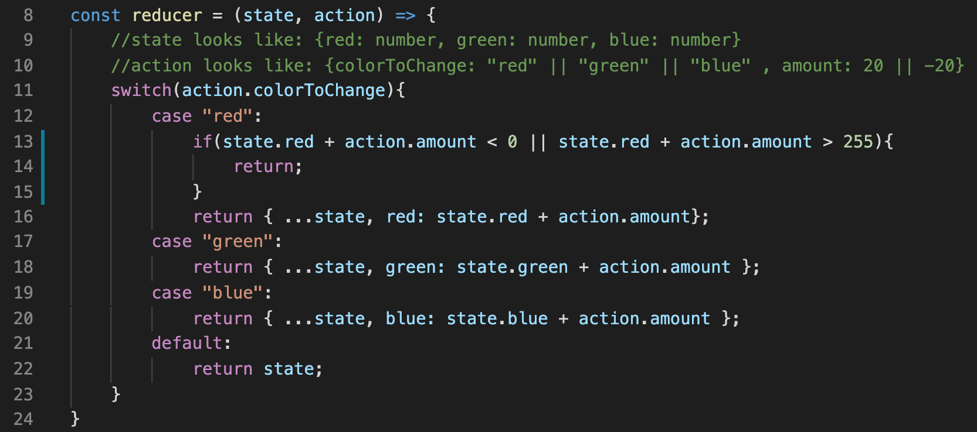
Creating a Reducer
SquareScreen.js
Calling dispatch runs our reducer – which (is supposed to) return what the new state is.
Regardless, once the reducer returns, the component it is used in re-renders.
But then, what happens if we are in the case where red is a “bad” value, and we return nothing?

Slide 66
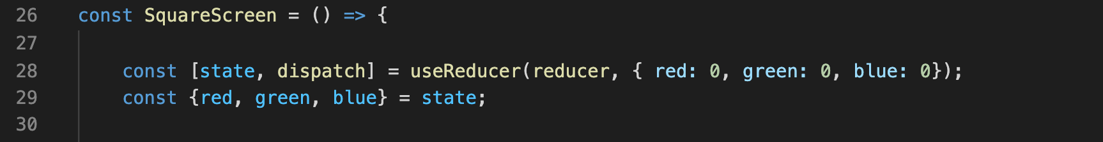
Creating a Reducer
SquareScreen.js
Well, if you go back to our functional component, we recall that the state that our reducer returns gets stored in this state variable.
And at present, the very first thing we’re doing is destructuring it! Trying to store ‘red’ in its own variable!
But that will only work if state has a property called red.
And if our reducer returns nothing, it won’t! It won’t have any properties!
And thus why it crashed and complained about ‘red’ missing!

Slide 67
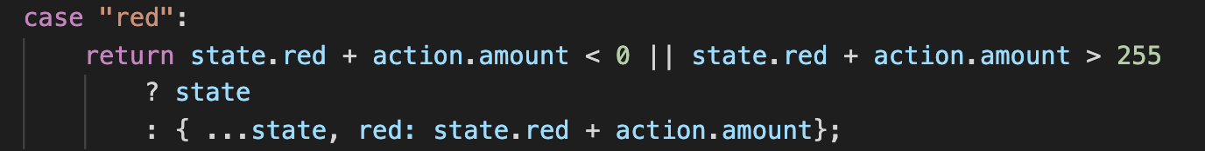
Creating a Reducer
SquareScreen.js
And if you were so inclined, you could use the ternary expression here as well!
We open with return…
And then the ternary expression will select one of two things to return
If the Boolean expression evaluates to true (i.e., the value is bad) return the current state.
Otherwise, return the object that contains the adjusted state.

Slide 68
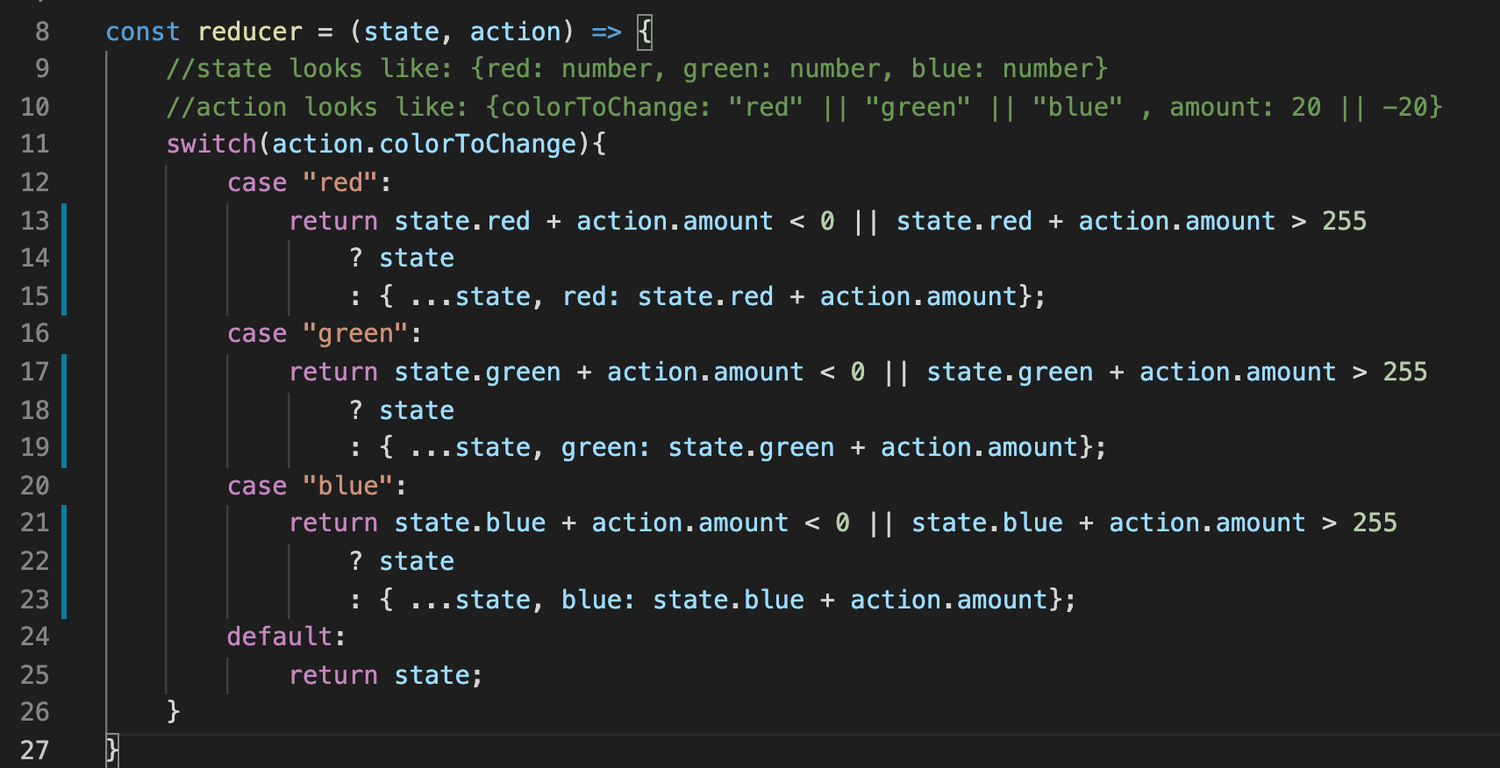
Creating a Reducer
SquareScreen.js
And so then the reducer might end up looking a little something like this!

Slide 69
Creating a Reducer
So great! We did it! We made a lovely reducer! And without the loss of data validation!
As said a few times: this will set us up for greater success in the future!
Before we close out, let’s chat about a few community conventions.

Slide 70
Today’s Agenda
Introduction to Reducers
Creating a Reducer
Some Reducer Coding Conventions

Slide 71
Reducer Convention
It’s helpful to know about conventions for a couple of reasons!
It means that if another engineer were to ever look at your code, they would immediately understand what certain variables are meant to do.
Just like how in Java, you can immediately tell if a type is a primitive type or a non-primitive type by whether or not it begins with a capital letter!
But it also means that *you* will be better equipped to read code written by others, too!
Like, say, if you were ever looking something up on Stack Overflow ;)

Slide 72
Reducer Convention
So, our action object that our reducer used had these properties, yeah?
{colorToChange: ‘red’, amount: 20}
As it turns out, reducer action objects typically have two very specific property names:
{type: ‘change_red’, payload: 20}
That is, action objects typically have a property named type, and a property named payload.

Slide 73
Reducer Conventions
{type: ‘change_red’, payload: 20}
The property “type” is a string that communicates what is the type of change to the state we are talking about here.
So the value ‘change_red’ implies that the type of change we wish to make to the state is to change the value of red!
And the property “payload” is any additional data that is necessary to make the change take place.
E..g, only knowing that we want to change_red does us little good; we also need to know by how much by.
That’s what the payload property is telling us in this case!

Slide 74
Reducer Convention
{type: ‘change_red’, payload: 20}
Note that if you wanted to refactor the code to use this…
The logic would all stay exactly the same!
You would just have to update the identifiers in a lot of places!

Slide 75
Reducer Convention
{colorToChange: ‘red’, amount: 20}
{type: ‘change_red’, payload: 20}
Everytime you used ‘amount’, you change it ‘payload’
Any time you use ‘colorToChange’ to change it to ‘type’
Any time you use the string ‘red’, ‘green’, or ‘blue’, you change it to ‘change_red’, ‘change_green’, ‘change_blue’ etc.
So it’s all very “easy” – just a bunch of things to change!
Depending on the editor you are using, there’s probably some pretty easy ways to ‘replace all’… if you dare!
I leave it as an exercise for you if you choose to embark on this convention!

Slide 76
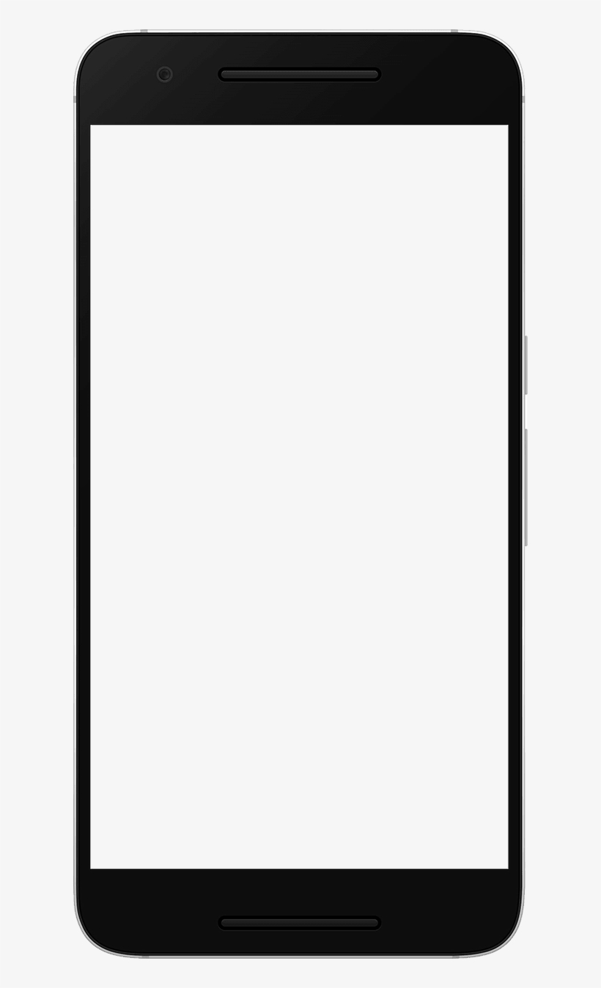
Reducer Convention
Increase
And yet another final challenge, if you are so inclined!
To give yourself some more practice using reducers…
Go back to the Counter app we first made, and convert it to use a reducer!
That is – eliminate all references to ‘useState’
And instead, only have ‘useReducer’
Because this app only had one piece of state, it’s maybe *a little silly* to use a reducer here
But still potentially pedagogically helpful!
Decrease
Current Count:
0

